Slide 1
THIS BRIEFING IS UNCLASSIFIED
Air Force Nuclear Weapons Surety Training
Current as of 25 Aug 16 w/55 WG supplemented 14 Mar 17

Slide 2
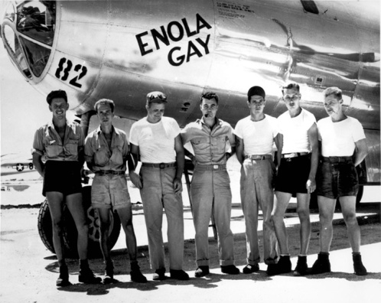
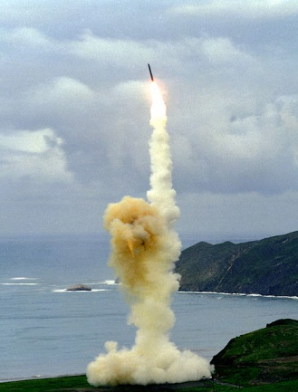
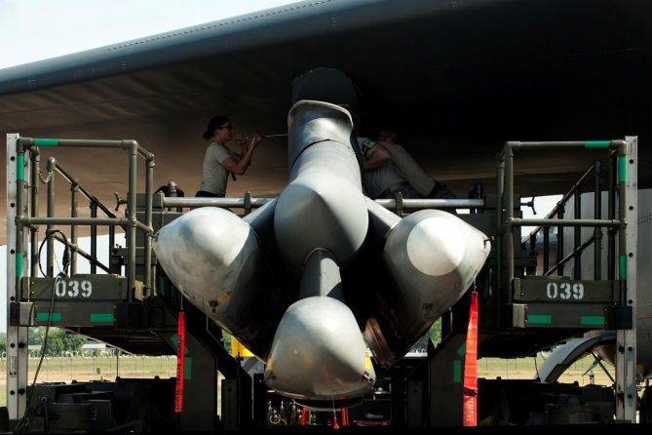
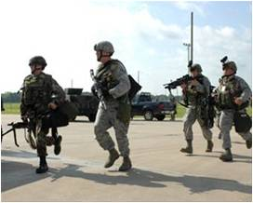
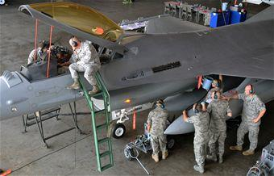
Nuclear Weapons Surety
Since its inception the Air Force Nuclear Mission has been a tremendous source of pride for U.S. citizens, our government and those who have directly and indirectly supported the mission
Notes:
During the Cold War, the threat was readily apparent as we had no doubt who and what the enemy was. Today, the situation is more dynamic as the threat can come from anywhere at any time. Our commitment to and pride in the deterrence mission is critical and must be unwavering.
The decades-long Cold War with the Soviet Union fostered a rich legacy of commitment and professionalism (built on extremely high-levels of nuclear surety) for the Air Force Nuclear Enterprise. The consequences of not “standing up to the Cold War threat” would have been dire for America – and our perseverance was, and remains, a huge source of pride for the nuclear professionals who served then and now.
While the threats we face today are not the same as the Cold War, our deterrence mission remains a crucial element of America’s national security posture and will continue as such well into the future. Similarly, you should be fully aware of and appreciate the magnitude and importance of your mission – and feel no less pride in your contributions than the nuclear professionals of past decades.

Slide 3
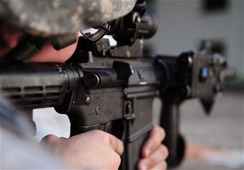
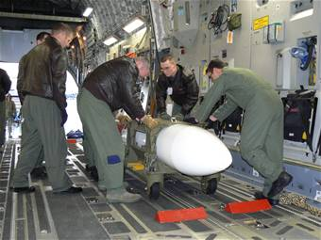
Nuclear Weapons Surety Overview
Importance and need for a U.S. nuclear capability
Nuclear Surety Culture
Nuclear mishap effects
Nuclear mishap prevention responsibilities
Weapon System Safety Rules
Mishap and hazard reporting
INRAD/ALARA
Security requirements
Two-Person Concept & SVA
MNCL/NCE
Personnel Reliability Assurance Program
Local specific training is highlighted in red
Test

Slide 4
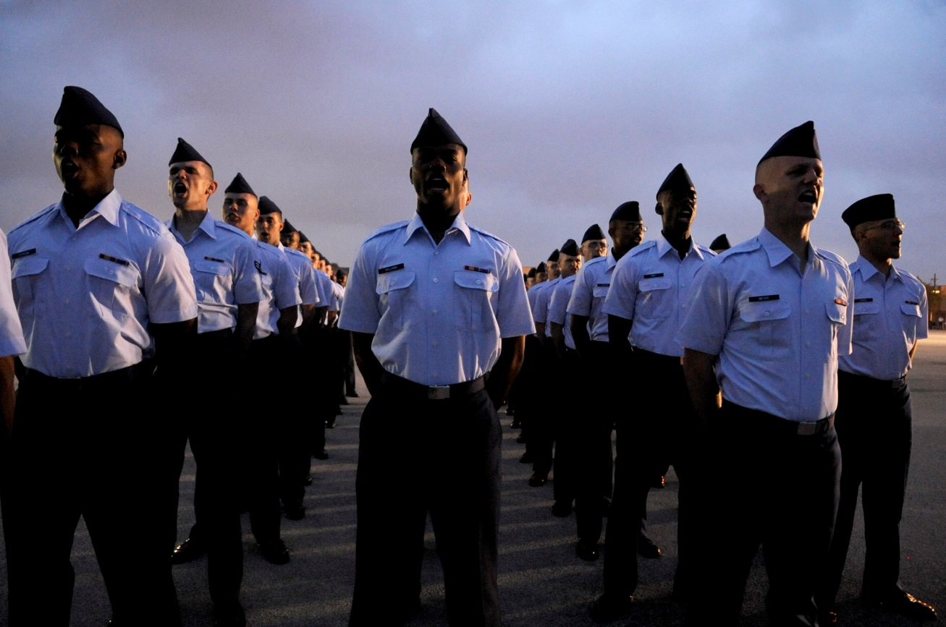
Nuclear Weapons Surety The Importance and Need for U.S. Nuclear Capability
The effective and credible nuclear surety you provide to our nation is critical to continued support for America’s Nuclear Deterrent Mission
Notes:
What you do as a steward of the nuclear mission prevents the US and its allies from falling. If there were no longer a nuclear deterrent, it would not be long until we, as a nation, fall.
Public support of the nuclear mission is critical. If the perception is that we cannot do our job effectively, then we lose support and funding for modernization.
Therefore, it is imperative that we, as a nuclear community do our jobs correctly to remain in a positive light.
• Domestic support (Congress and the American Public) is crucial to the AF Deterrent Mission. This support can be negatively impacted, for example, by the 2007/2008 incidents involving inadvertent air transport of nuclear weapons and the shipment of classified nuclear equipment to another country. These incidents, although very rare in occurrence, damaged the credibility of our Enterprise and the national support of our citizens and leaders.
• The current high levels of nuclear surety you and your professional teammates provide daily equate to national confidence and trust in our nuclear deterrent forces. America respects its nuclear deterrence professionals as highly trained and professionally responsible stewards of this nation’s nuclear arsenal. Regardless of an individual’s role in the mission – operations, maintenance, security or support – our citizenry understands the criticality of what our nuclear professionals provide to this nation on a 24-7-365 basis.
• Administration and Congressional support for continued funding and modernization of America’s nuclear deterrent are directly related to national and congressional leadership having positive views of DoD stewardship and, importantly, high levels of surety within our nuclear deterrent.

Slide 5
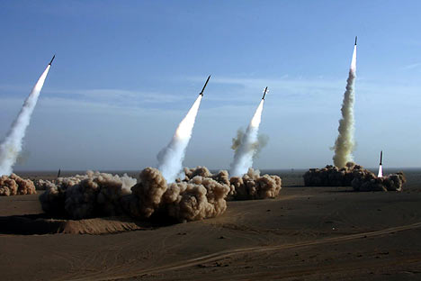
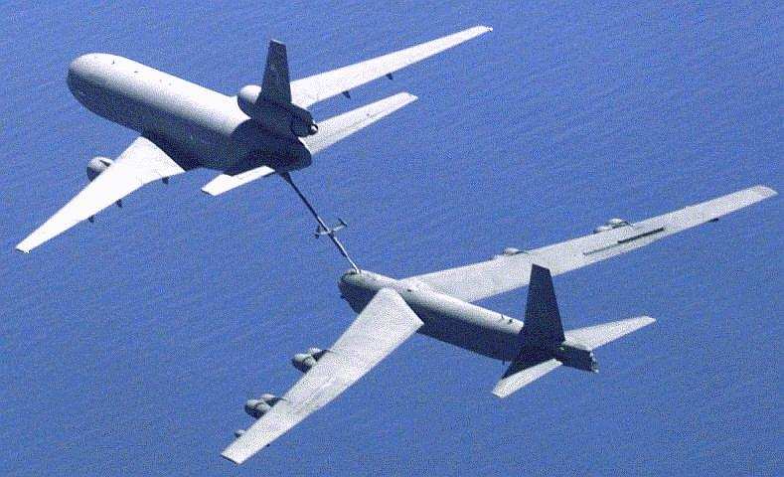
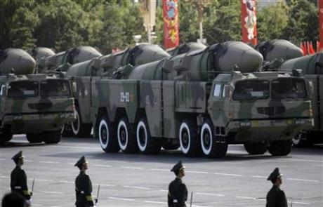
Importance of and Need for U.S. Nuclear Capability
Deter adversaries from attacking the U.S. with weapons of mass destruction (WMD)
Assure Allies and partners of our commitment to their security
Dissuade potential adversaries from developing WMDs
The only in-kind response to a WMD attack the U.S. chooses to maintain

Slide 6
History of Nuclear Weapons
6 August 1945, “Little Boy” released over Hiroshima
Equivalent to over 15,000 tons of TNT
9 August 1945, “Fat Man” released over Nagasaki
Equivalent to over 20,000 tons of TNT
Post World War II
Cold War & Arms Race (1947-1991)
U.S.S.R. and U.S. significantly expand nuclear arsenals & weapon stockpiles
By 1964, five nations maintain a nuclear weapons program/capability
1970 - Treaty on the Non-Proliferation of Nuclear weapons
Established Nuclear and Non-Nuclear States
189 member countries
By 2006, three additional nations developed nuclear weapons

Slide 7
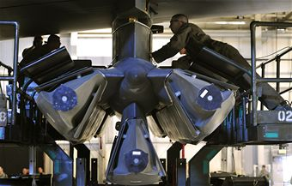
Possible Adverse Effects Nuclear Surety Incidents/Mishaps
The Nuclear Deterrence Mission you are engaged in and support each day is the most critical, “can’t fail” mission in America today
Notes:
Although it may seem like we who maintain the nuclear deterrent mission are un-appreciated, you don’t realize how appreciated you are until we are threatened; by the enemy or by complacency. By definition alone, we deter the enemy. However, we must be vigilant against complacency. Because when it comes down to it, if we fail at our job, the country fails.
• You are entrusted with operating, maintaining, defending and supporting America’s deployed nuclear forces – the most powerful weapons in the world which form the bedrock of our nation’s security
To fully appreciate this, consider the point that no one else in America goes to work each day with the extremely high levels of responsibility and expectations that you assume.
As noted in the recent NPR and Strategic Posture Commission Reports, Nuclear Deterrence is and will remain hugely important to U.S. national security.
The contributions of professionalism and trust you provide to our nation are understood and appreciated by our leadership and citizens alike.

Slide 8
Possible Adverse Effects Nuclear Surety Incidents/Mishaps
Nuclear weapons are designed inherently safe to prevent unauthorized or accidental nuclear yields
The AF also protects nuclear resources and prevents mishaps through:
Personnel Reliability Assurance Program (PRAP)
Nuclear Certification (systems, equipment, processes)
Formalized procedures (AFIs, T.O.’s WSSRs, etc.)
YOU are essential to nuclear surety and must comply with DoD and AF guidance to prevent incidents/mishaps
Nuclear incidents or mishaps have far reaching consequences
Negative political and psychological effects
Loss of public and ally confidence in our ability as stewards
Can cause tremendous loss of life and/or property

Slide 9
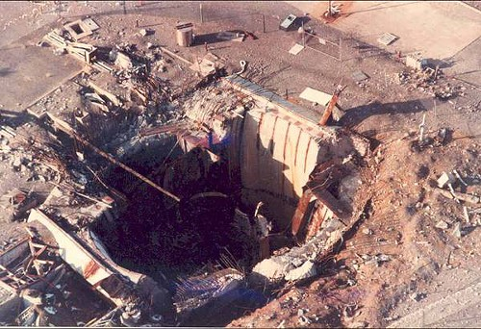
Nuclear Surety Incidents/Mishaps
Damascus, Arkansas (1980)
Maintainer drops socket down silo, hitting missile wall and causing fuel leak
Explosion blew 740-ton hatch into the air
1 dead, 21 injured
$250M in damages
Over $719M in 2016 dollars
Complete loss of site

Slide 10
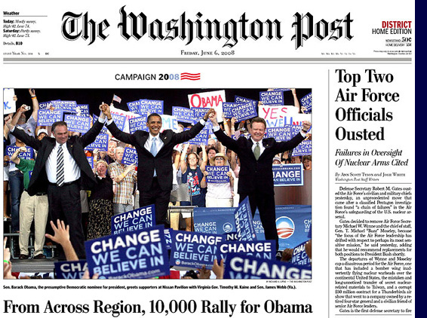
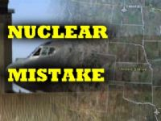
The Minot Daily News
Nuclear bombs mistakenly flown over US
Tuesday September 26 2007
Wednesday, September 5, 2007
The officials who spoke on condition of anonymity say the incident prompted an Air Force investigation and the firing of a munitions Squadron Commander.
The plane was carrying Advanced Cruise Missiles from the Minot base to Barksdale Air Force Base in Louisiana last Thursday. It's unclear why the warheads were not removed before the missiles were put on the bomber.
Officials say there was minimal risk to crews and the public because of safety features designed into the munitions.
In addition to the squadron commander who was fired, crews involved with the mistaken load have been temporarily decertified for handling munitions.
The Air Combat Command has ordered a command-wide stand down on Sept. 14th to review procedures.
Washington (AP) Pentagon officials say a B-52 bomber from Minot Air Force Base was mistakenly armed with six nuclear warheads and flown for more than three hours across several states last week
Notes:
The two events that occurred in 2006 and 2007 alerted senior Department of Defense (DoD) officials to unacceptable practices in the handling of nuclear weapons and nuclear weapons-related materiel within the U.S Air Force.
One incident was the unauthorized weapons transfer from Minot Air Force Base (AFB) in North Dakota to Barksdale AFB in Louisiana in August 2007, which was due to a breakdown in procedures in the accounting, issuing, loading, and verification processes.
The first known flight by a nuclear-armed bomber over U.S. airspace in almost 40 years -- a B-52 bomber is mistakenly loaded with six nuclear warheads and flown from Minot Air Force Base to Barksdale Air Force Base. The error goes unnoticed for almost 36 hours. Several Air Force-wide investigations are conducted and four USAF commanders are relieved of their commands

Slide 11

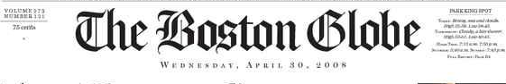
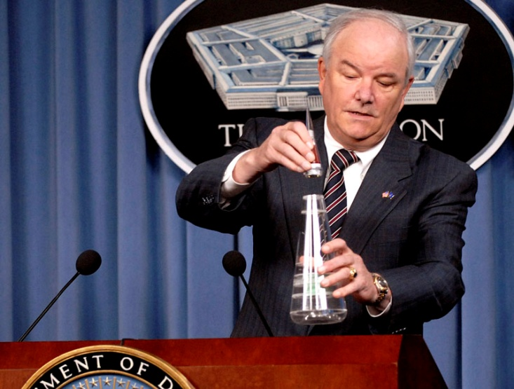
TUESDAY March 25, 2008
Warhead fuses mistakenly sent to Taiwan
Devices shipped instead of batteries for helicopters
WASHINGTON - Four high-tech electrical fuses for Minuteman nuclear warheads were sent to Taiwan instead of helicopter batteries, a mistake discovered only last week - a year and a half after the erroneous shipment, Pentagon officials disclosed yesterday.
Officials said the nose-cone fuses, designed to send an electrical signal to the warhead's trigger as it plummets toward its target, resembled those used for conventional munitions and contained no nuclear material.
Even so, the mistake is another embarrassment for the people
in charge of America's nuclear weapons. The Air Force disclosed last year that it unwittingly let a B-52 bomber carrying six nuclear cruise missiles fly from North Dakota to Louisiana.
The US government is struggling to prevent the technology for nuclear weapons from spreading to nations that do not already have them. It has raised a public outcry against North Korea and Iran for their nuclear ambitions, and even criticized Russia for not sufficiently safeguarding its stockpile.
Air Force Secretary Michael W. Wynne demonstrates the positioning of a nose cone assembly for the Minuteman missiles during a press briefing inside the Pentagon March 25. The non-nuclear assemblies were mistakenly sent to Taiwan in 2006.
Notes:
The other incident involved the mis-shipment of four forward-section assemblies used on the Minuteman III intercontinental ballistic missile (ICBM). The assemblies are sensitive missile components and, as such, require special handling. Owing to errors and omissions in inventory control and packaging, on two separate occasions in October and November 2006, assemblies were sent to Taiwan. These shipments were intended to fulfill a foreign military sales order for helicopter batteries. Because of subsequent deficiencies in supply chain management, the components were not properly recovered until March 2008.
Defense Secretary Robert Gates orders a complete inventory of the nation's nuclear arsenal and all associated components after the discovery that four classified nuclear ICBM parts have been mistakenly sent to the country of Taiwan. An error that has gone unnoticed for more than 18 months

Slide 12
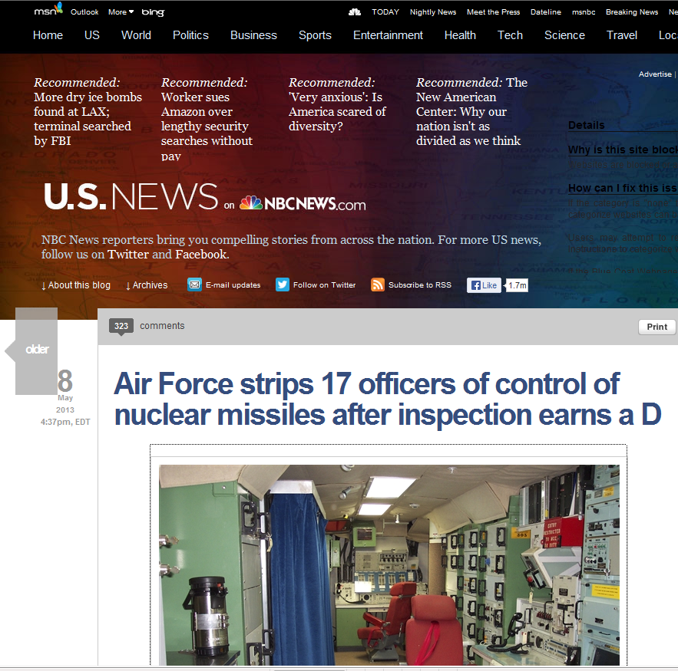
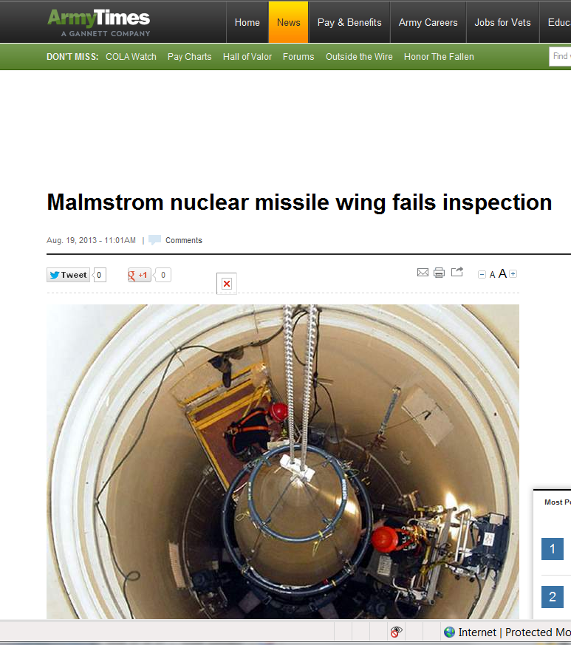
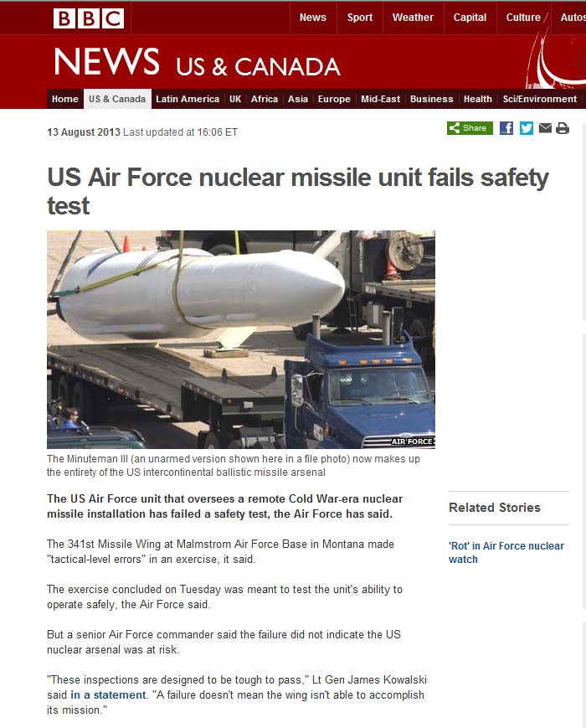
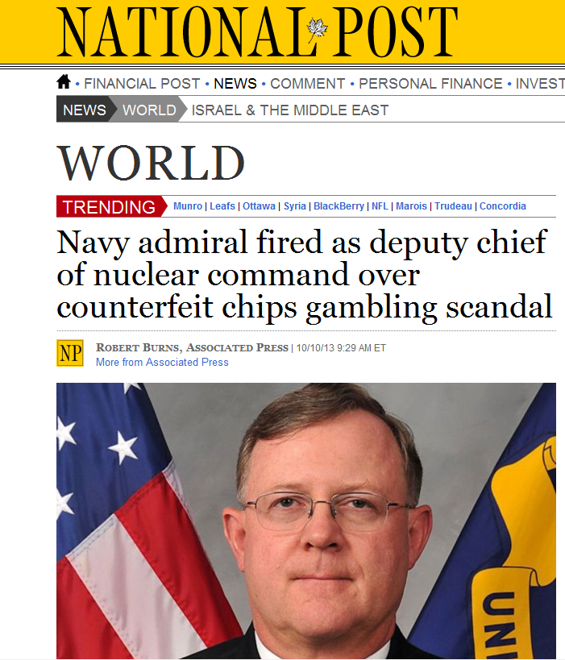
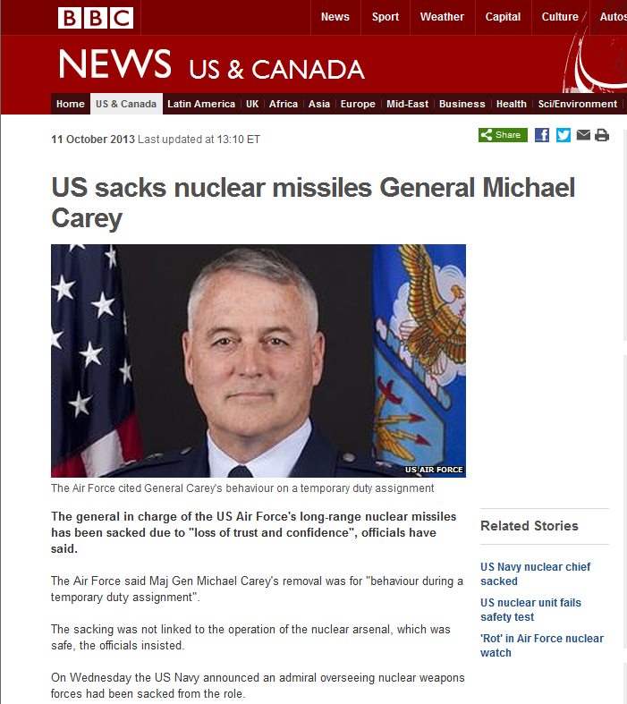
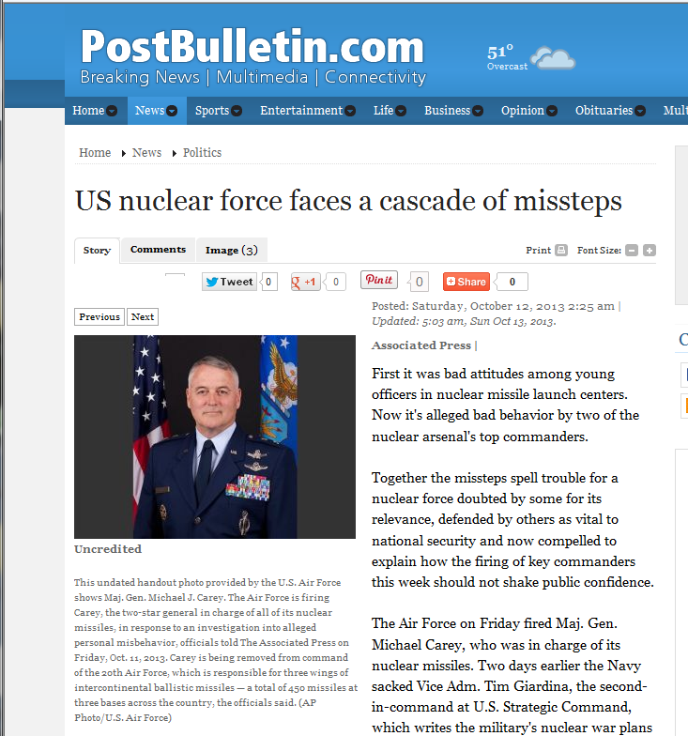
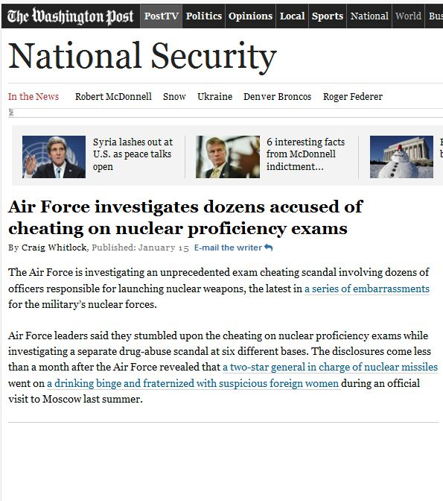
Nuclear Weapons Surety
Notes:
But it seems that new headlines appear regularly that talk to the “state of the enterprise” Each click brings up another headline—no words go along with these slides--

Slide 13
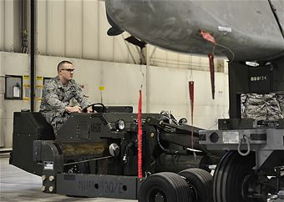
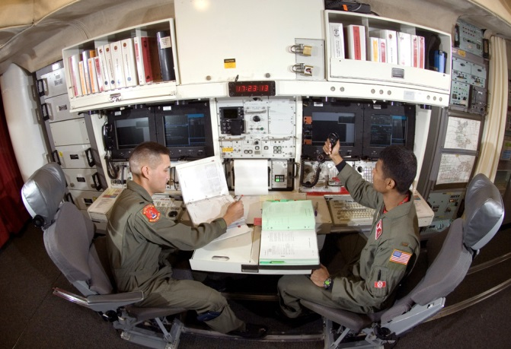
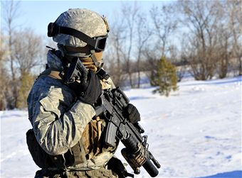
Nuclear Surety Responsibilities
The highly credible nuclear surety you provide to America each day is an important factor in supporting our nuclear mission and our nation

Slide 14
Nuclear Surety Responsibilities
Commander’s Responsibilities
Security, safety, & handling of nuclear weapons
Materials regardless of storage, generation, or employment
Individual Responsibilities
Everyone is responsible for nuclear surety culture, regardless of rank
Must inform supervisor(s) if not qualified to perform task
Must report any nuclear safety hazards, deficiencies, or security problems
Anyone deemed unreliable must be identified to supervisor(s)
Must inform supervisor(s) about anything that could affect your own ability or reliability to perform task
14

Slide 15
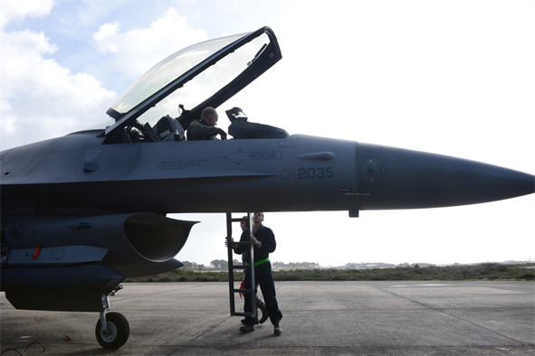
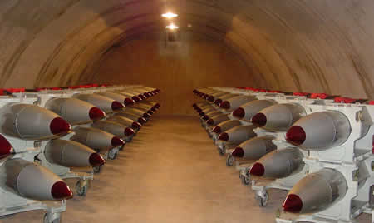
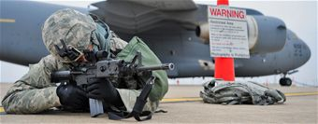
Nuclear Weapon Surety
The Air Force Nuclear Surety Program
Incorporates maximum nuclear surety, consistent with operational requirements; from development to dismantlement
What is Nuclear Surety?
Policies, Procedures, Controls and Actions contributing to the Safety, Security and Reliability of Nuclear Weapons

Slide 16

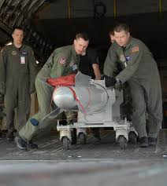
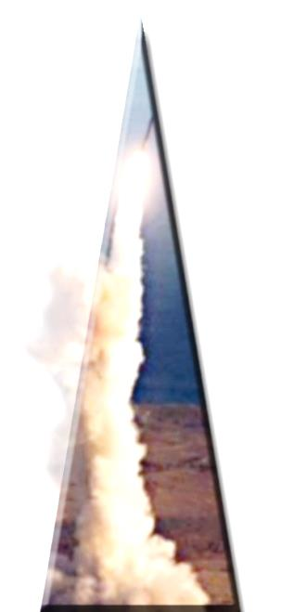
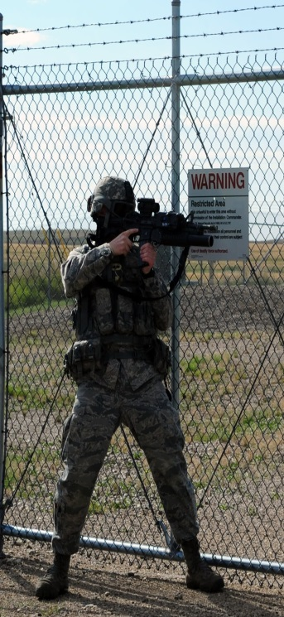
Nuclear Weapon Surety Weapon System Safety Rules
DoD Nuclear Weapon System Surety Standards
Positive measures to:
Prevent Unauthorized Nuclear Yield
Prevent DELIBERATE
Weapons Incidents
Prevent INADVERTENT Weapons Incidents
Ensure Adequate
Security

Slide 17
Weapon System Safety Rules
Apply to all nuclear weapons/systems
Each weapons system has unique safety rules that apply
Safety rules ALWAYS apply, even during war!!!
Nuclear weapons SHALL NOT be:
Intentionally exposed to abnormal environments; except during an emergency
Used for training/troubleshooting (confirmation of fault existence/fault isolation)
Nuclear weapons may be used for exercises if not prohibited by WSSRs and with proper authorization
17

Slide 18
Nuclear Weapons Surety Mishap and Deficiency Reporting
Certain actions must be taken after nuclear mishaps/incidents
IAW AFMAN 91-221, Nuclear accidents, incidents, or deficiencies must be reported to your commander/supervisor
Reports are required for those mishaps, events, or conditions which degrade or could degrade nuclear safety
Wing Weapons Safety offices are the focal point for nuclear mishap reports
The sole purpose of safety investigations is to prevent future mishaps/incidents
18

Slide 19
625 STOS Mishap Reporting Procedures
Anyone detecting, discovering or witnessing a TPC Violation or Mishap will immediately:
Notify Alert MC & ALCS/Intel
Use secure communications, if available
Report the following information:
Name/Rank
Time of occurrence
Location
Critical components involved
Brief description of event
Do Not delay the report if secure communication is not available
Notify unit additional duty weapons safety rep and fill out Dull Sword worksheet, forward to 55 WG/SEW for Dull Sword report determination
19

Slide 20
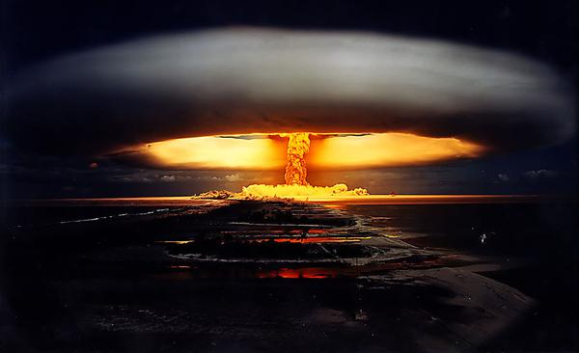
Mishap and Deficiency Reporting
Nuclear accidents, incidents, and deficiencies are all required reports. Nuclear accidents and incidents are reported using Flagwords
20

Slide 21
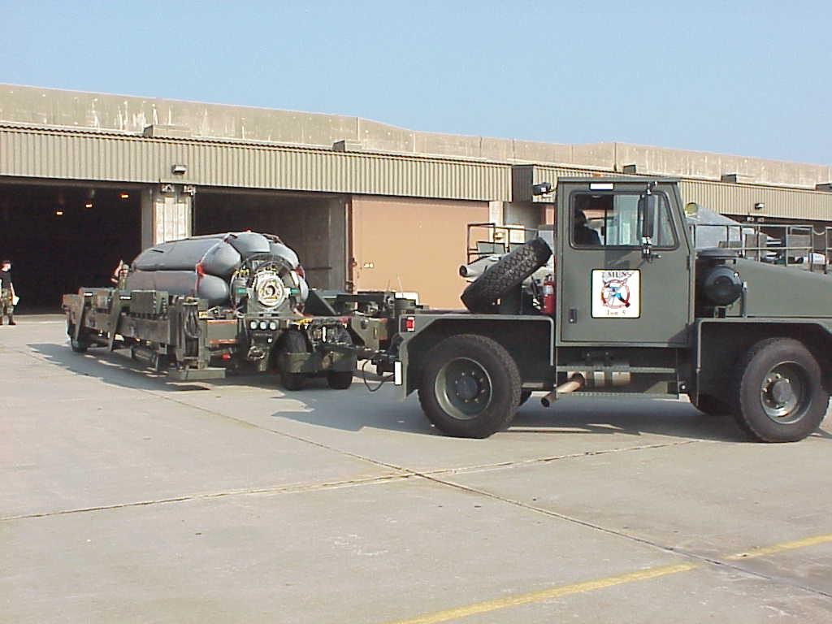
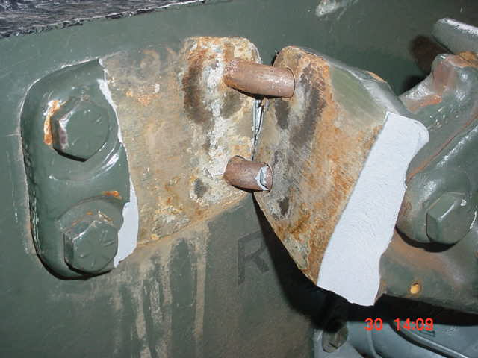
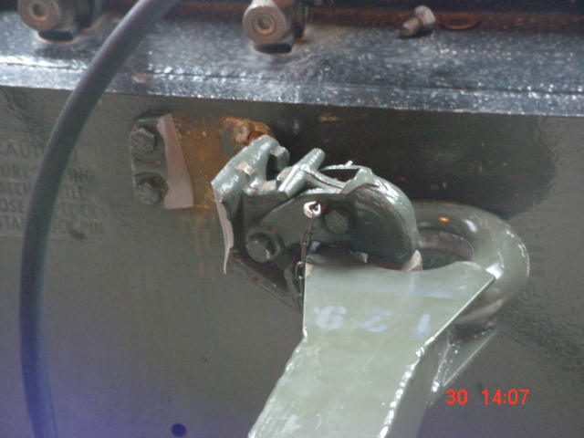
DULL SWORD Deficiencies
ID’s deficiencies through cross-tell and trend analysis to enhance nuclear surety
ID’s the potential for a nuclear mishap
Deficiencies not included in the accident or incident categories but meeting any of the criteria listed in AFMAN 91-221 shall be reported
Bases without a nuclear mission that own or use nuclear certified equipment listed in the Master Nuclear Certification List (MNCL) must report DULL SWORDs
Wing Weapon Safety Managers will determine if report is required
21

Slide 22
DULL SWORD Examples Deficiencies
Operational, Security, Maintenance, and Other Examples
Malfunction, failure, or anomaly that results in Command & Control indications or critical function activation
Malfunction, failure, or anomaly during operations or testing resulting in a safety or coded device to arm or left in an unsafe condition
Malfunction or failure of monitoring equipment/software that is part of an intrusion detection system at a nuclear facility
Use of uncertified equipment, hardware or software on a nuclear weapon or weapon system
Damage to a nuclear weapon, or nuclear certified support/test equipment listed in the MNCL
WSSRs violations
22

Slide 23
BENT SPEAR Nuclear Incident
Mishaps not in the accident category, but fit the following criteria
Radioactive contamination from burning, theft, seizure, inadvertent release of content, or destruction of a radioactive limited-life component
Inadvertent initiation of a limited-life component or damage to a nuclear weapon/component that requires major rework, replacement, examination, or re-certification by the DoE
Requires immediate action in the interest of nuclear surety
Nuclear warhead has been armed without proper authorization
Could lead to a nuclear weapon system accident and warrants information up channeled to HQ AF or higher command authorities

Slide 24
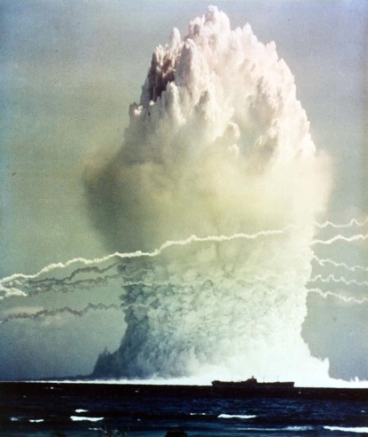
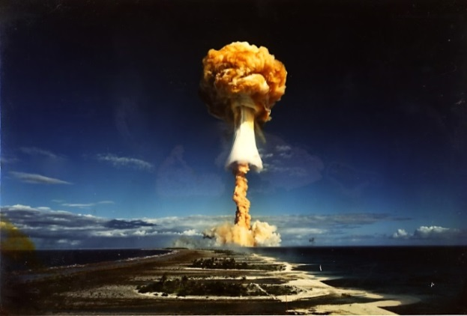
NUCFLASH Nuclear Weapon Accident
Accidental, unauthorized, or unexplained events that could create the risk of war
Accidental, unauthorized, or unexplained actual or possible nuclear detonation
Accidental or unauthorized launch of a nuclear armed or nuclear capable missile
Unauthorized flight/deviation from approved flight plan by nuclear armed or nuclear capable aircraft that could
be perceived as a hostile act
24

Slide 25
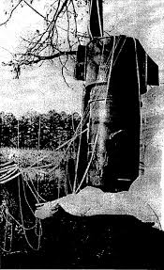
BROKEN ARROW Nuclear Weapon Accident
Accidental, unauthorized, or unexplained events that could not create the risk of war
Accidental or unauthorized launching, firing, or use by U.S. forces or U.S. supported forces
Accidental, unauthorized, or unexplained nuclear detonation
Non-nuclear detonation or burning of a nuclear weapon or nuclear component
Radioactive contamination which doesn’t fall within BENT SPEAR category
Public hazard - actual or perceived
Jettisoning of a nuclear weapon and/or component
25

Slide 26
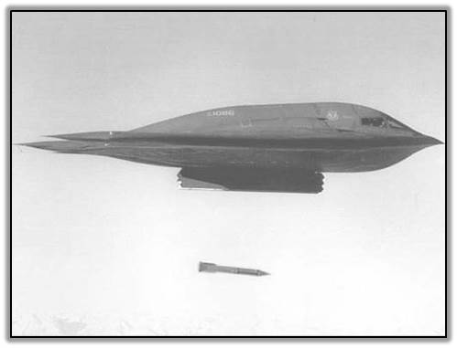
EMPTY QUIVER Nuclear Weapon Accident
Nuclear weapon is lost, stolen, seized, or destroyed
Loss includes, but is not limited to, intentional jettisoning according to approved AF procedures, or inadvertent release, of a nuclear component
26

Slide 27
Nuclear Weapons Surety Mishap and Hazard Reporting
The Bottom Line
Report ALL deficiencies on equipment/software listed in the MNCL
Stop the operation and notify your Wing Weapons Safety Manager using your local procedures
The Wing Weapons Safety Manager will investigate the mishap and report the occurrence if necessary
MAJCOM, AF Safety Center, or commander can require a DULL SWORD be written
27

Slide 28
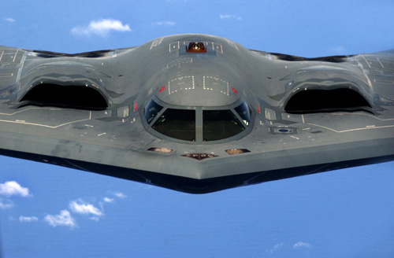
Nuclear Weapons Surety
Should America face a significant national security crisis involving weapons of mass destruction, it is critical to our national leaders that you and members of your team are trained and perform to the highest levels of nuclear surety standards
Notes:
• Should such a crisis arise, our President and military and civilian leaders must deal with it knowing that the surety (safety, security and reliability) of their nuclear forces is rock-solid.
• The good news in such a crisis is that our nation-level leadership will know they can depend on the Air Force Nuclear Enterprise because its professionals are frequently trained, tested and evaluated to provide solid, highly professional and responsive actions as directed in high-pressure environments.

Slide 29
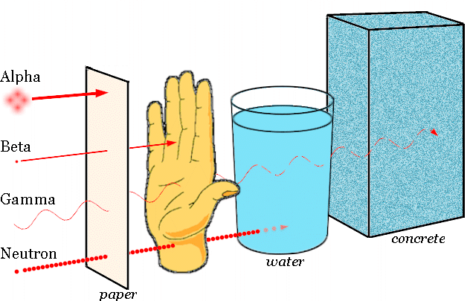
Nuclear Weapons Surety Intrinsic Radiation
Intrinsic Radiation (INRAD) – Ionizing radiation emitted through the weapon’s surface
Ionizing radiation – Electromagnetic/particulate radiation capable of causing ionization (i.e. formation of ions) as it passes through matter
Alpha, Beta, Gamma, X-rays, Neutrons
INRAD Safety Training:
https://kx.afms.mil/kj/kx5/RadiationPrograms/Pages/home.aspx

Slide 30
Nuclear Weapons Surety As Low As Reasonably Achievable
ALARA – A concept to minimize personnel exposure consistent with existing technology, cost, and operational requirements
Most Technical Order (T.O.) procedures incorporate ALARA procedures
Three basic ALARA principles
Time – Limit amount of time spent around nuclear weapons
Distance – Be no closer to the weapon than duties require
Shielding – Use shielding techniques when appropriate
Time - Distance - Shielding

Slide 31
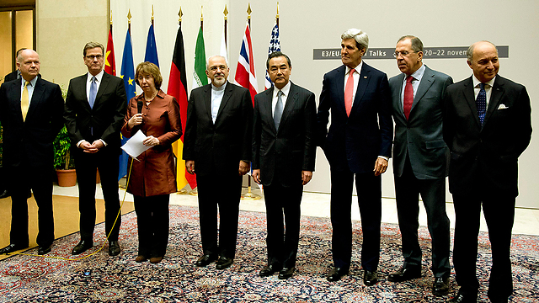
Nuclear Weapons Surety
America’s credible deterrent forces have been and will continue to be major factors in international stability. Because of this, what you do everyday is critical to how our allies, international partners, and adversaries view our nuclear deterrent capabilities and credibility
Notes:
If we, as a superpower were to disarm ourselves, it would not be long until stability throughout the world would suffer. Smaller, allied nations would be overrun, and eventually so too would the US.
• A key facet of the international stability afforded by our nuclear capabilities relates directly to the U.S. doctrine of Assurance. Also known as Extended Deterrence, this doctrine extends a nuclear umbrella to prevent coercion from adversaries, does away with the need for Allies to develop their own nuclear weapons/forces and discourages potential adversaries from developing nuclear arsenals.
• Another important tenet of U.S. policy and international stability is nuclear non-proliferation. Credible U.S. nuclear deterrent capabilities directly support non-proliferation. The “eye of the beholder” concept also plays a large role in non-proliferation, as U.S. deterrent credibility – supported by high levels of nuclear surety, reduces and/or eliminates the need for nations to develop and field nuclear weapons.

Slide 32
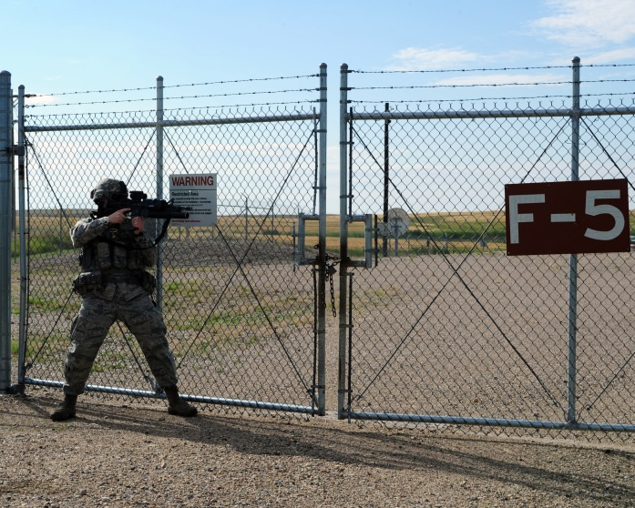
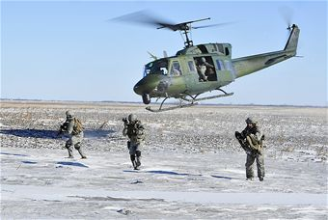
Nuclear Weapons Surety
Having a highly credible nuclear surety program is vital to the nuclear mission and to the defense of the United States
Notes:
As anyone in our business knows, our weapons are NOT on a hair-trigger. There are many levels of safety built in. And the notion of de-alerting cannot even be entertained as our alert forces are critical to the deterrence mission.
• It is very important for you to be able to point to the professionalism and high level of nuclear surety inherent in today’s AF Nuclear Enterprise - these are powerful and factual arguments against the notion of “Hair Trigger Alert” and the need for “De-Alerting.”

Slide 33
Nuclear Weapons Surety Protection Level 1
Protection Level (PL) 1 – Assets for which the loss, theft, misuse, compromise, damage or destruction would result in great harm to strategic capability or catastrophic consequences for the U.S.
Nuclear weapons/nuclear critical components
Air Force One
Command, Control, Communications, and Computer systems critical to nuclear missions (NC4)
Must result in the greatest possible deterrence against hostile acts

Slide 34
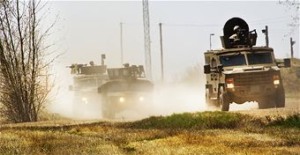
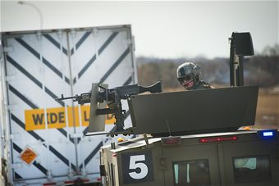
Nuclear Weapons Surety Security Incidents
Two terms you should know
COVERED WAGON – Report to inform HHQ that an unusual incident affecting PL-1,2, or 3 resources occurred (probably or actually hostile)
OPREP-3 Report – A report to inform commanders of information essential to command and control of forces

Slide 35
Nuclear Weapons Surety Exclusion Areas / No-Lone Zones
Exclusion Area – A designated area immediately surrounding one or more nuclear weapons
Boundaries are defined by the walls, floors, and ceiling of a structure or are delineated by a permanent or temporary barrier
Exclusion areas are No-Lone Zones
No-Lone Zone – An area where the two person concept must be enforced because it contains a nuclear weapon, nuclear weapon system or certified critical component
Not all no-lone zones are exclusion areas

Slide 36
625 STOS/DOO Access Requirements
Any two individuals on the Entry Authority List (EAL) are authorized to enter the Close In Security Area (Red Diamond)
In order to “break the skin” of the alert-configured aircraft a Two-Person Control Team (TPCT) must be formed. A TPCT consists of:
Two individuals identified by an “X” on the EAL must be the first to enter the aircraft and the last to leave it
At least one of the two individuals must possess a TS/SCI clearance which is identified by a “$” on the EAL
After entry, the battle staff compartment must be occupied at all times by two “Xs”; at least one will be a “$”.
Note: Only one member of the TPC team may be interim PRP certified.
36

Slide 37
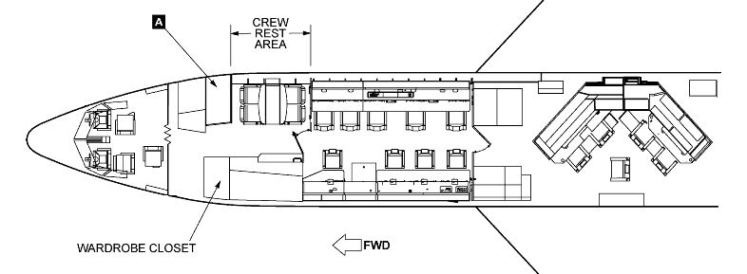
Manned E-6B No-Lone Zone Areas
LAVATORY
Flight Deck Battlestaff Comm Dept
When the aircraft is ALCS-loaded, the No-Lone Zone is defined as the area from the rear of the Battle Staff compartment bulkhead forward to the nose of the aircraft with exception of the head and forward lower lobe
49

Slide 38
Nuclear Weapons Surety Certified Critical Component
Critical Component - If bypassed, activated, or tampered with could result in/contribute to deliberate/inadvertent authorizing, prearming, arming, or launch of a combat delivery vehicle carrying a nuclear weapon, or the targeting of a nuclear weapon to other than its planned target
Tamper – To knowingly perform an incorrect act or unauthorized procedure involving a nuclear weapon, nuclear weapon system, or certified critical component
Nuclear Weapon System – Combat delivery vehicle with its nuclear weapon or weapons and associated support equipment, noncombat delivery vehicles, facilities, and services
38

Slide 39
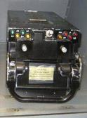


625 STOS/DOO ALCS Critical Components
Code Processor Equipment (CPE)
Critical component without crypto variable
Code component with crypto variable
Requires two officer code handlers (AB)
Volatile Keying Assembly (VKA)
Code component requiring split-handling
A-VKA: two officer (AX) control
B-VKA: two officer (BX) control
Test VKA’s are critical components only
Portable Storage Unit (PSU)
Critical component
Test PSU is also a critical component
39

Slide 40
625 STOS/DOM Critical/Non-Critical Components that Require TPC
625 STOS/DOM Critical Components:
Execution Plan Program (EPP)
Quality Inspection Check Program (QUICK)
Minuteman Operational Targeting Program (MOTP)
Trajectory and Missile Parameter Data Base (TAMP DB)
Execution Plan Program Data Base Generator (EPP DBG)
Single Integrated Operations Plan (SIOP) and Targeting Applications Computer System (STACS) Hard Drive
DOM NON-Critical Components, but require TPC:
MERGER Program
Mission Planning Program (MPP)
Launch Facility Master Data Base (LF Master DB)
Operational Targeting Program Data Base (OTP DB)
Execution Plan Program/Message Analysis Data Base (EPP/MA DB)
Target Case Input/Execution Plan Case Input (TCI/EPCI) tapes/CDs
40

Slide 41

625 STOS/DOO Critical Components Installed in Equipment Rack
41

Slide 42
Nuclear Weapons Surety Two-Person Concept
Two-Person Concept – Two authorized personnel granted access to nuclear weapons, weapon systems, or critical components
Ensures that a lone individual is denied access to nuclear weapons, nuclear weapon systems or critical components
Prevents a lone individual from performing an incorrect or unauthorized act or tampering with nuclear weapons, weapon systems or critical components
Team consists of at least two individuals who:
Are PRAP certified IAW DoD 5210.42R & AFMAN 13-501
Know the nuclear surety requirements of the task they perform
Can detect an incorrect act or unauthorized procedure
Successfully completed nuclear surety training IAW AFI 91-101
Are designated to perform the required task

Slide 43
Nuclear Weapons Surety Sole Vouching Authority
Exclusion area entry requires both the Entry Controller and Sole Vouching Authority (SVA) approval
There is only one SVA per exclusion area
The SVA
Identifies individuals attempting to gain entry, validates need for entry, validates authorization
May hand off responsibility to another individual provided both individuals jointly recognize the change
43

Slide 44
Nuclear Weapons Surety National Defense Area / Safe Haven
National Defense Area (NDA) established off base to protect PL 1–3 resources and classified material
Private lands come under the temporary jurisdiction of the Air Force (DoD)
CONUS only
OCONUS units follow host nation agreements
Safe Haven – Temporary storage of Dept. of Energy classified shipments at Dept. of Defense facilities
Ensures safety and security of nuclear material and non-nuclear classified material
May be coordinated in advance or as need arises
CONUS only

Slide 45
Nuclear Weapon Surety Nuclear Certification Program
All Nuclear Weapon Systems/associated equipment are nuclear certified before being fielded
Includes procedures, software, and facilities
Changes/modifications to equipment/weapon systems are thoroughly reviewed before approval
Only nuclear certified equipment can be used for nuclear operations
Unauthorized modification(s) can void certification

Slide 46



Nuclear Certified Equipment Example

Slide 47

Nuclear Weapon Surety Master Nuclear Certification List
AFNWC web-based program
Listed by nomenclature & National Item Identification Number (NIIN)
Units verify the current status of specific items
https://wwwmil.nwc.kirtland.af.mil/mncl/index.cfm

Slide 48

Master Nuclear Certification List

Slide 49






Nuclear Certified Items & Equipment
Nuclear Certified Items (NCI)
Parts of the nuclear weapon system
Nuclear Certified Equipment (NCE)
Tools and equipment used to operate/maintain the weapon system
Only certified items / equipment will be used for nuclear operations
Common hand tools do not require MNCL listing
Refer to AFI 91-103, Air Force Nuclear Safety Design Certification Program and AFI 63-125, Nuclear Certification Program

Slide 50


Nuclear Weapons Surety
The existence of, and your participation in the Personnel Reliability Assurance Program (PRAP) is proof-positive that America’s nuclear professionals are trustworthy, loyal, responsible, healthy and dedicated
Notes:
All airmen on PRAP are vetted through a rigorous process. Yes, some commit big mistakes. But, the entire nuclear community being stigmatized because a select few committed a mistake is like saying ALL drivers are bad because a handful decided to drive drunk.
• Because America’s Nuclear Deterrence Mission is so critical to national security, commanders and leaders must be totally certain the officers, enlisted and civilians involved are fully loyal, fit and trustworthy. PRAP provides the full-time assurance, at the lowest levels of command, that our men and women can be trusted to perform their portions of the broader mission without question.
• PRAP can provide answers to potential questions from outside the nuclear community (e.g., from citizens, Congress and other leaders) such as: “How do you know people involved in our nation’s Nuclear Deterrence Mission are trustworthy and medically qualified to perform such an important mission?

Slide 51
Nuclear Weapons Surety Personnel Reliability Assurance Program
Ensures that personnel with access to/knowledge of nuclear weapons meet the highest standards of personal reliability
It’s an important component/adjunct to the two-person concept
Ensures individuals are:
Physically, Emotionally and Psychologically reliable
Able to perform assigned tasks
Initial and refresher training administered by AF/A10 through the Air Force Portal
PRP and Arming and Use of Force (AUoF) training shall be completed in conjunction with AF nuclear surety training
51

Slide 52
Nuclear Weapons Surety PRAP and You
PRP and AUoF are functionally the same…
Both programs ensure that only reliable individuals are assigned duties involving nuclear weapons.
…but administratively different.
PRP continues to follow the DoDM 5210.42_AFMAN 13-501
AUoF follows functionally similar guidance in AFI 31-117
PRP and AUoF both satisfy PRAP requirements, as a result members certified under both programs (Security Forces under AUoF and all other AFSC’s under PRP) can fulfill two person concept duties.

Slide 53







Nuclear Weapons Surety PRAP Impact to You
Big Picture….Under PRAP:
Security Forces personnel (AFSCs 31PX and3P0XX) will utilize Arming and Use of Force per AFI 31-117
All other AFSCs will utilize PRP per DoDM 5210.42_AFMAN 13-501
Security Forces Utilize AUoF
All other AFSC’s Utilize PRP

Slide 54

Nuclear Weapons Surety
The high standards of nuclear surety within Deterrent Forces are driven by:
Unique political significance
Destructive power of nuclear weapons
Strategic deterrence mission
Compliance with those standards are:
Absolute and regulatory in nature
Maintains public confidence
Not associated with other weapons
Notes:
By rigorous compliance with nuclear surety standards, we ensure:
• That we can decisively employ nuclear weapons upon authorized direction from the President of the United States…..and only under those conditions.
• That absent that lawful order, the nuclear weapons in our custody are safe, secure and
reliable.

Slide 55
Nuclear Weapons Surety Local Specific Training
MAJCOM approved local specific training may be presented at this point or incorporated within this plan to ensure proper flow of ideas
55

Slide 56
625 STOS/DOO Proper Configuration of Alert E-6B
PSU: the Mass Storage Device/Loader (MSD/L) is in the aircraft equipment rack. The PSU is locked in the MSD/L with two S&G (combination) locks.
VKAs/CPE: The VKAs are latched in the CPE.
Unmanned: The CPE is locked in the aircraft equipment rack with two S&G (combination) locks.
Manned: The CPE is locked in the aircraft equipment rack with two key-activated (slick) locks.
Note: S&G and key-activated locks will be divided between “A” and “B” group code handlers
56

Slide 57
625 STOS Pre-Task Brief
Requirement per AFI 91-101
Located at each applicable No-Lone Zones
Ensure you review the briefing prior to establishing a No-Lone Zone and accomplishing TPC operations.
Brief newcomers into already established No-Lone Zones
Review of Pre-Task Briefing Memorandum
57

Slide 58
Nuclear Weapons Surety Test
You must pass a closed-book nuclear surety test with a score of 80% to complete this training
The test includes a minimum of 2 questions for each of the 10 mandatory topics
Additional test questions pertaining to local specific topics may be added
58

